Slide 1
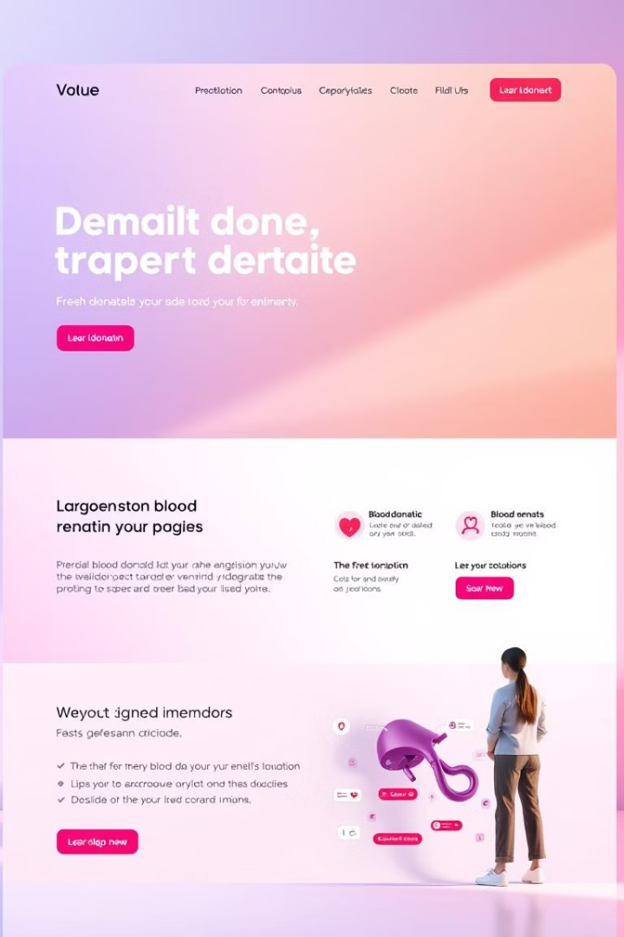

Blood Donor Finder
Connecting donors and recipients.
Team member:
Faiyaz Bin Jahangir_ 38112
MD Zahed Hossain_38125
MD Ismail Hosen_ 38127
MD Lokman Huda Hriday_ 38135
Ekthiar Uddin_38142
BGC trust University Bangladesh

Slide 2

Project Goals
1
Ease of Use
2
Donor Privacy
Simple and intuitive interface.
Protect sensitive donor information.
3
Efficiency
4
Accessibility
Streamline the blood donation process.
Accessible to all potential donors.

Slide 3



Tools
Web Development
Database
Security
HTML, CSS
MySQL
Encryption, authentication
Frontend development
Storing donor information
Data protection
User interface design
Efficient data retrieval
User account security

Slide 4
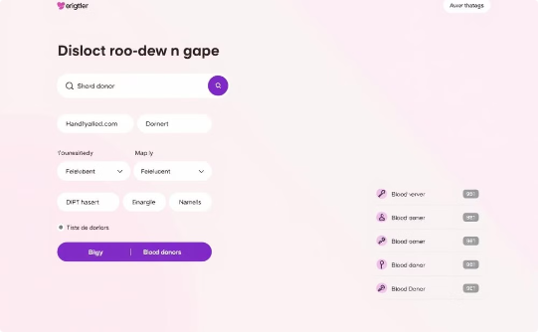
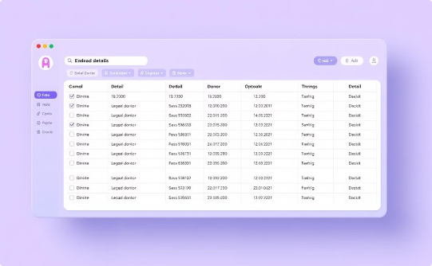
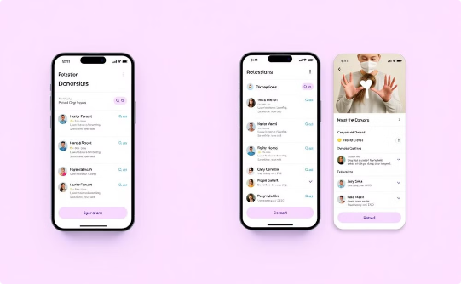
System Architecture
User Interface
Database Query
Display Results
A user enters their blood type and location. The application retrieves potential donors based on this information.
The application queries the database to find donors with matching blood types within the specified location.
The application displays a list of potential donors, including their contact information and other relevant details.

Slide 5
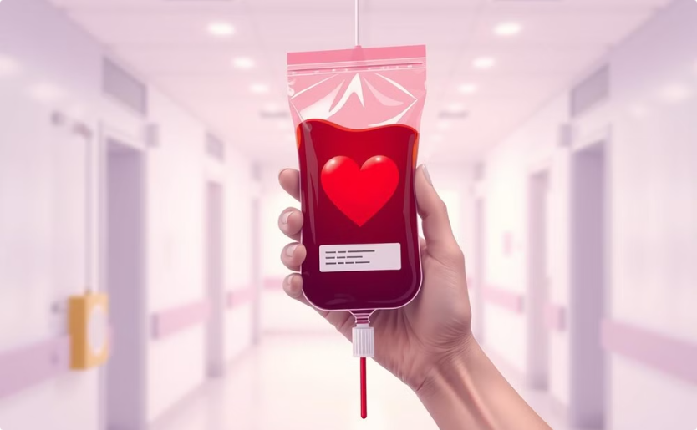

Conclusion
Connecting Donors
Saving Lives
The Blood Donor Finder makes it easier to connect donors with those in need.
This helps save lives by making blood donations more accessible.

